Slide 1
ECATP_50v3
coverage requirement
Post processing tool
Tutorial updated by: Jose Daniel Rodríguez Sánchez.
17-10-2010
Notes:
ECATP
2010-05-27

Slide 2
ECATP_50v3
The aim of this tool is post process the log files generated after the coverage verification test, in order to analyze the requirement of Signal Strength, according to the ICE values defined in the contract.
  “RAT” better than -70 dBm
  “Localidades” better than -85 dBm
  “Main Roads” better than -85 dBm
Notes:
ECATP
2010-05-27

Slide 3
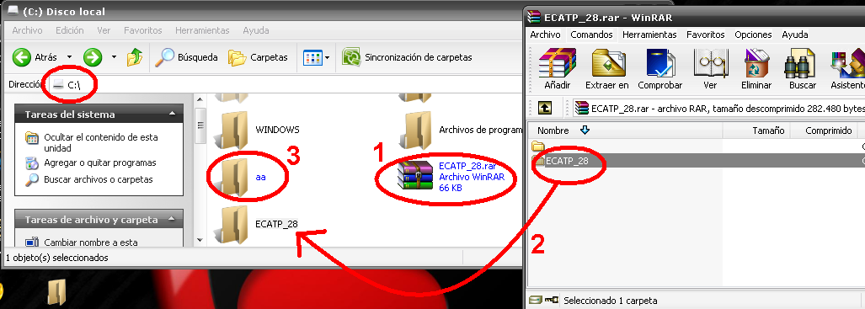
Tutorial for ECATP _50v3 :Step by Step
We need to copy ECATP_50v3.rr file on C:\
Then we need to unzip information on C:\
And make the C:\aa\ file for post-processing execution.

Slide 4
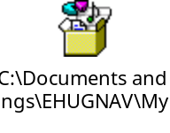
ECATP _50v3
4. Export the Frequency Scan Drive Test from TEMS Investigation with this mask.
5. Or this one if it was performed with several MSs
Notes:
ECATP
2010-05-27

Slide 5
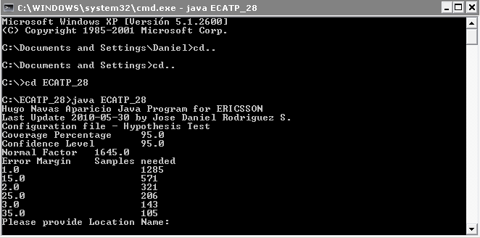
ECATP _50v3
To execute the java program ECATP_50, you need follow this steps:
1. Open the Command window.
2. Go to C:\
3. Insert on the command window cd ECATP_50v3
4. And Execute the program with java ECATP_50
Notes:
ECATP
2010-05-27

Slide 6
ECATP_50v3
5. The First question we look is the Name Location. In this Example Santa Ana. So you need to type Santa Ana.
6. The next question is Number Location. 41 for Santa Ana.
7. Then type the test Area. In this Example Area type is RAT.
8. Name of who is running the tool.
9. And file name to process:
CATP_28ARFCN_Santa Ana.txt

Slide 7
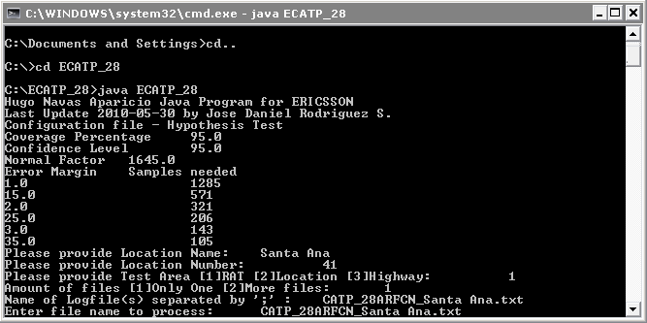
ECATP_50v3
11. All this looks like the following picture: After this press enter.

Slide 8
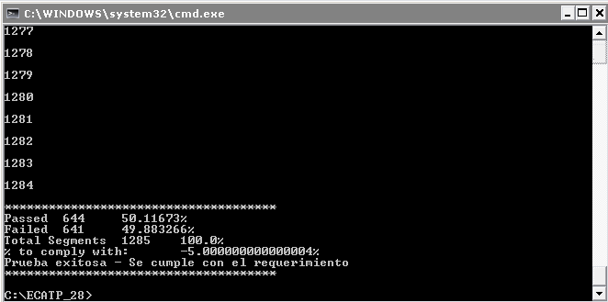
ECATP_50v3
12. Then will see a summary of the process. You have to press enter to continue.
13. Press 2 if you don’t want. And you will see something like this:

Slide 9
ECATP_50v3
14. Open in MapInfo Location_ID_internal ericssonpreviously converted from Location_ID_internal ericsson.txt
15. Erase the invalid measurements
16. Select the valid data
17. Export the selection into a text file
18. Open a DOS window and go to the directory C:\aa
19.Type java ECATPadapt for an adapted file from MapInfo (previously processed with ECATP)
20. Follow the instructions
21. Look for the results in C:\aa (a new fileis created)
22. For MapInfo process the file named Location_ID_internal ericsson.txt (create points, etc).
Notes:
ECATP
2010-05-27

Slide 10
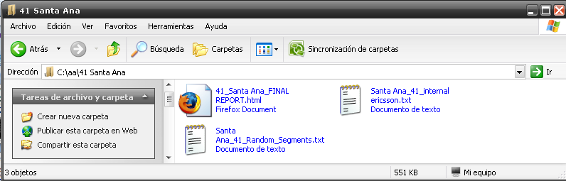
ECATP_50v3
23. The new files created on C:\aa look like this:
24. The HTML file is ready for been printed. And looks like the following picture.

Slide 11
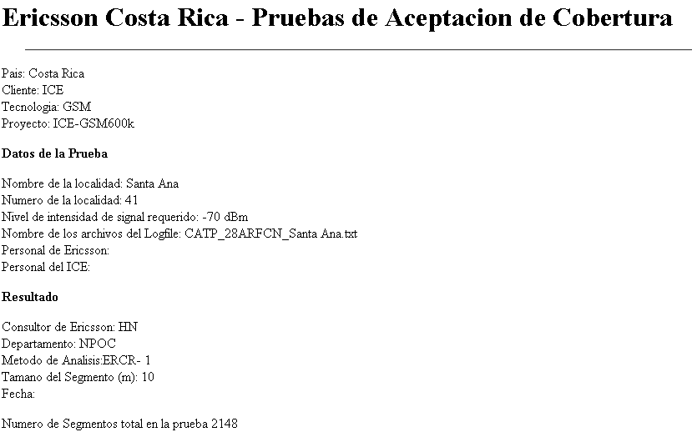
ECATP_50v3

Slide 12
ECATP_50v3
Precautions that you need.
Be sure all files needed are on ECATP_50v3, when you run java ECATP_50. Also the file you are going to process. In this Example: CAPT_28ARCN_Santa Ana.txt.
Also the HPTC.txt file is needed. It configure some variables on the program.
Other files needed: ECATP_50.class, ECATPadapt.class, hptest.class, Keyin.class,rawsamplenode.class, verketteteliste.class. (Looks like the next picture)

Slide 13
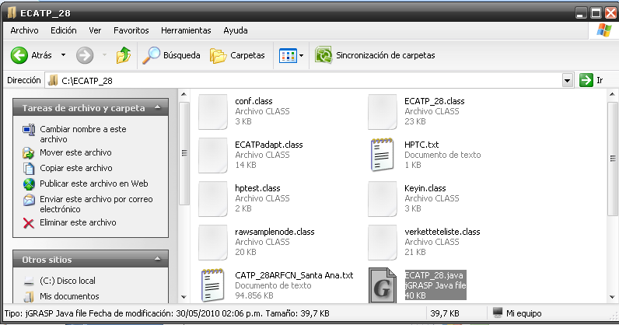
ECATP_50v3

Slide 14
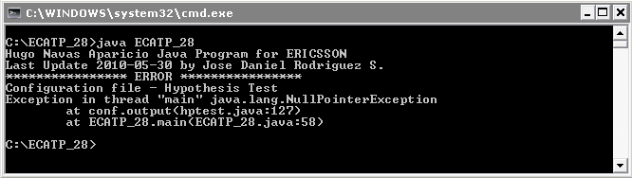
ECATP_50v3
Common Errors:
The name of the file that you want to process has different name.
You don’t create the C:\aa file.
You don’t have the Configuration file HPTC.txt in the same directory C:\ECATP_50v3. The messages looks the following picture.

Slide 15

Notes:
ECATP
2010-05-27

